Slide 1


BOOTSTRAP
Lecture-9

Slide 2
Today’s Agenda
BootStrap Inputs
Text Input
Setting Sizes
Adding Hep Text
Input States
Input Groups
Custom Controls

Slide 3
BootStrap Inputs
Now lets discuss about more Bootstrap 5 form elements.
We have already covered buttons so now we will go through Bootstrap 5 text inputs and custom inputs like checkboxes, radio buttons and select pickers.

Slide 4
Text Input
The inputs that are created for text are <input> and <textarea>.
They both need the .form-control class to get the Bootstrap 5 inputs look

Slide 5
Example
<div class="container">
<div class="row">
<div class="col-8">
<label for="input1">Email address</label>
<input type="email" class="form-control mb-3" id="input1" placeholder="name@example.com">
<label for="textarea1">Your Description</label>
<textarea class="form-control" id="textarea1" rows="3" placeholder="Write your story here..."></textarea>
</div>
</div>
</div>

Slide 6
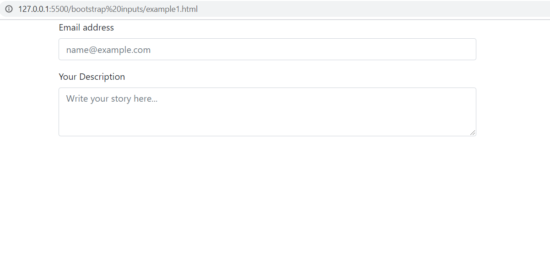
Output

Slide 7
Setting Sizes
We can modify the dimensions of the text inside the inputs and their height with the classes .form-control-sm for a smaller input and .form-control-lg for a bigger input.

Slide 8
Example
<div class="container">
<div class="row">
<div class="col-8">
<input class="form-control form-control-sm mb-3" type="text" placeholder="Small input">
<input class="form-control mb-3" type="text" placeholder="Default input">
<input class="form-control form-control-lg mb-3" type="text" placeholder="Large input">
</div>
</div>
</div>

Slide 9
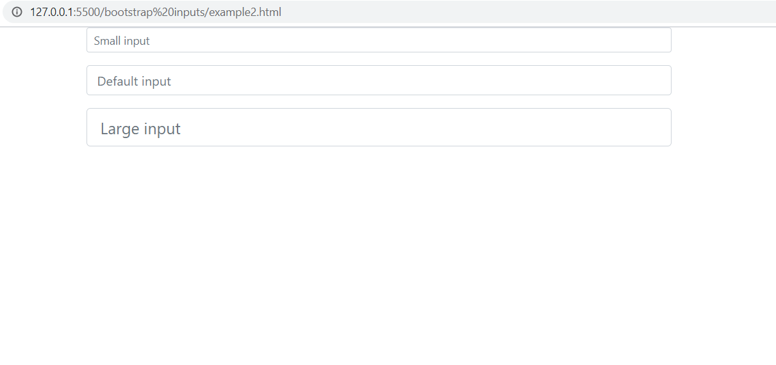
Output

Slide 10
Adding Help Text
We can add an explanation to our input with a block of text next to it.
Bootstrap 5 has a special class for this called .form-text.
This makes the element it is used with a block and adds a top margin.

Slide 11
Adding Help Text
We can use this class with tags such as <small>, <span> or <p>.
If we want to change how the help block looks, we can use the text utilities given by Bootstrap 5 typography.

Slide 12
Example
<div class="container">
<div class="row">
<div class="col-8">
<label for="inputPassword">Password</label>
<input type="password" id="inputPassword" class="form-control">
<span class="form-text text-info">
Your password must be 8-20 characters long, contain letters and numbers, and must not contain spaces, special characters, or emoji.
</span>
</div>
</div>
</div>

Slide 13
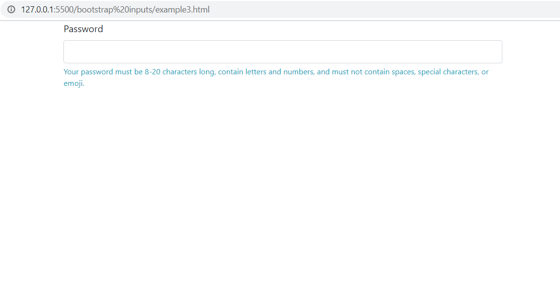
Output

Slide 14
Input State-Disabled
To prevent user interactions for an input, we can add the disabled attribute.
It will appear lighter and won’t take any input.

Slide 15
Example
<div class="container">
<div class="row">
<div class="col-8">
<input class="form-control mb-3" type="text" placeholder="This is a disabled input." disabled>
</div>
</div>
</div>

Slide 16
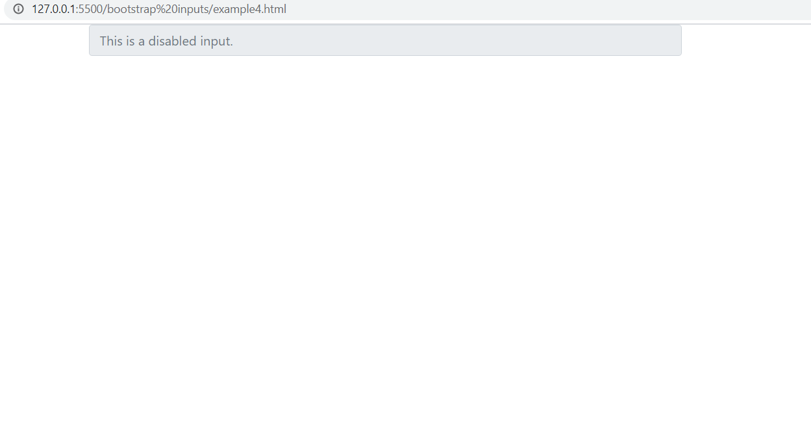
Output

Slide 17
Input State-Read Only
We can disable an input with the readonly attribute too.
The difference between disabled and readonly is that the readonly inputs retain the focus.

Slide 18
Example
<div class="container">
<div class="row">
<div class="col-8">
<input class="form-control mb-3" type="text" placeholder="This is a readonly input." readonly>
</div>
</div>
</div>

Slide 19
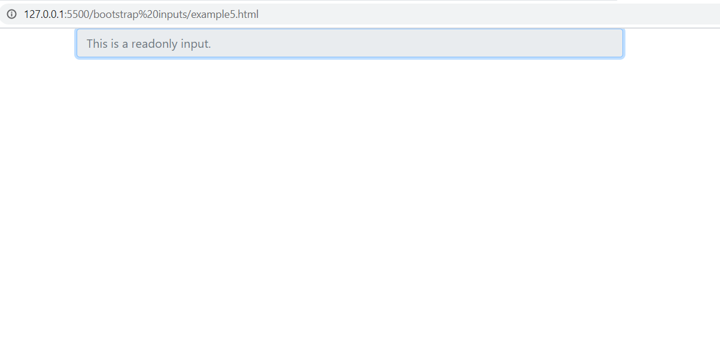
Output

Slide 20
BootStrap 5-Input Groups
We can extend an input by adding an add-on on either side.
An add-on is a text, icon or button that helps the user understand the use of the input

Slide 21
Basic Input Group
To create an input group we need an element with the .input-group class that holds both the .form-control and the add-on.
The input can be a text input, a textarea, a custom select or a file upload..

Slide 22
Basic Input Group
If we want to place the add-on before the input, we need to use the .input-group-prepend class.
And if we want the add-on after the input, we need to use the .input-group-append class.
But from BootStrap 5 we do not need these .input-group-prepend and .input-group-append classes

Slide 23
Example
<div class="input-group mb-3">
<div class="input-group-prepend">
<span class="input-group-text" id="basic-addon1">@</span>
</div>
<input type="text" class="form-control" placeholder="Username" aria-label="Username" aria-describedby="basic-addon1">
</div>
<div class="input-group mb-3">
<input type="text" class="form-control" placeholder="Recipient's username" aria-label="Recipient's username" aria-describedby="basic-addon2">
<div class="input-group-append">
<span class="input-group-text" id="basic-addon2">@example.com</span>
</div>
</div>

Slide 24
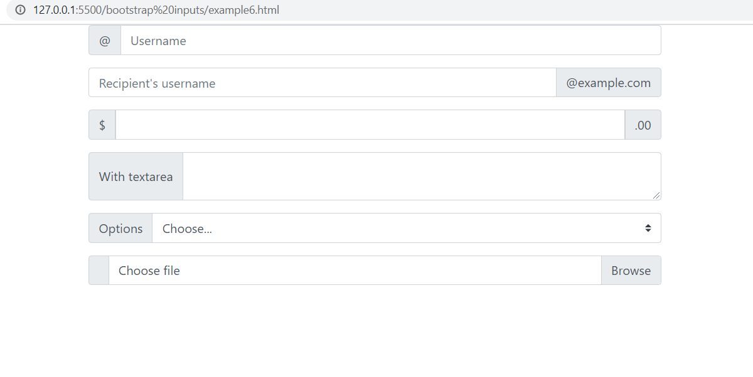
Output

Slide 25
Button Add On
We can make the add-on an actionable button

Slide 26
Example
<div class="col-8">
<div class="input-group mb-3">
<input type="text" class="form-control" placeholder="Recipient's username" aria-describedby="button-addon2">
<div class="input-group-append">
<button class="btn btn-info" type="button" id="button-addon2">Subscribe</button>
</div>
</div>
</div>

Slide 27
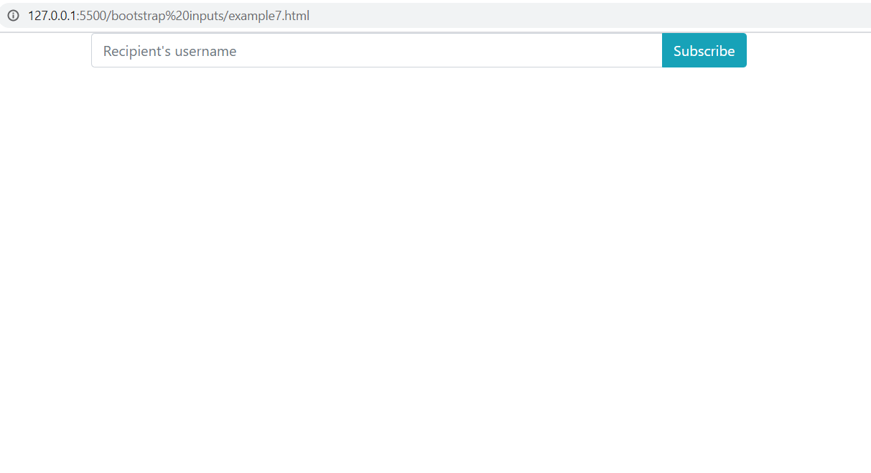
Output

Slide 28
Multiple Add On
An input group can have multiple inputs and multiple add-ons.
By placing the elements in the same .input-group div, they will be glued together.

Slide 29
Example
<div class="container">
<div class="row">
<div class="col-8">
<div class="input-group mb-3">
<div class="input-group-prepend">
<span class="input-group-text">First and last name</span>
</div>
<input type="text" aria-label="First name" class="form-control">
<input type="text" aria-label="Last name" class="form-control">
</div>
<div class="input-group mb-3">
<input type="text" class="form-control" aria-label="Dollar amount (with dot and two decimal places)">
<div class="input-group-append">
<span class="input-group-text">$</span>
<span class="input-group-text">0.00</span>
</div>
</div>
</div>
</div>
</div>

Slide 30
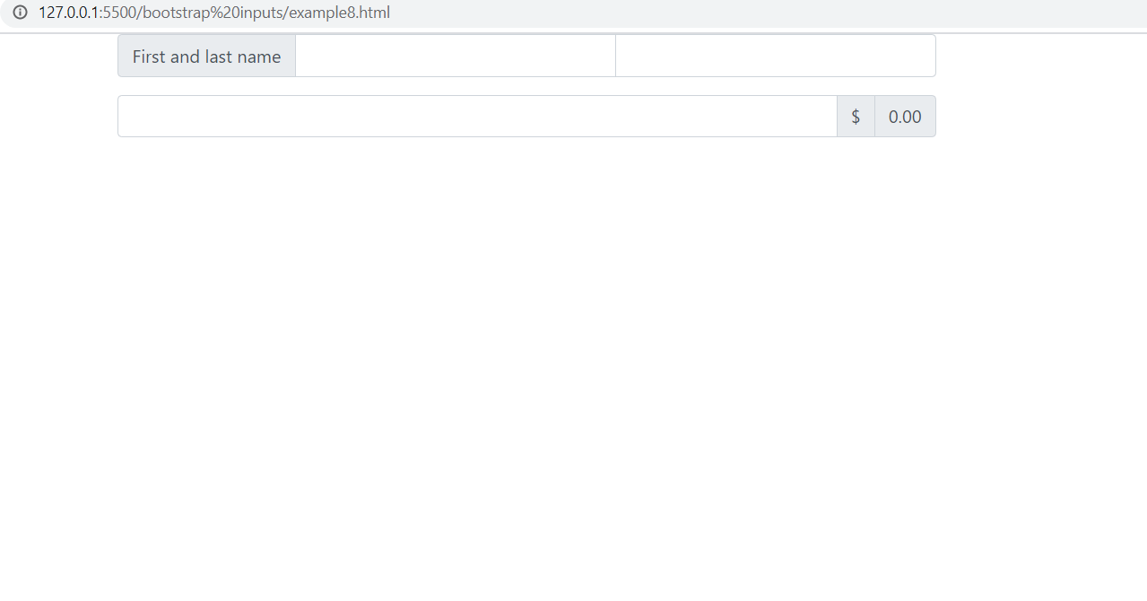
Output

Slide 31
Setting Sizes
If we want to size an input group, we need to add a sizing class on the input group and the inputs will automatically resize.
Sizing the inputs and add-ons individually is not supported.

Slide 32
Setting Sizes
There are 3 size options: the default one (no extra class added), the small one with the class .input-group-sm and the large one with the class .input-group-lg.

Slide 33
Example
<div class="input-group input-group-sm mb-3">
<div class="input-group-prepend">
<span class="input-group-text" id="inputGroup-sizing-sm">Small</span>
</div>
<input type="text" class="form-control" aria-label="Sizing example input" aria-describedby="inputGroup-sizing-sm">
</div>
<div class="input-group mb-3">
<div class="input-group-prepend">
<span class="input-group-text" id="inputGroup-sizing-default">Default</span>
</div>
<input type="text" class="form-control" aria-label="Sizing example input" aria-describedby="inputGroup-sizing-default">
</div>
<div class="input-group input-group-lg mb-3">
<div class="input-group-prepend">
<span class="input-group-text" id="inputGroup-sizing-lg">Large</span>
</div>
<input type="text" class="form-control" aria-label="Sizing example input" aria-describedby="inputGroup-sizing-lg">
</div>

Slide 34
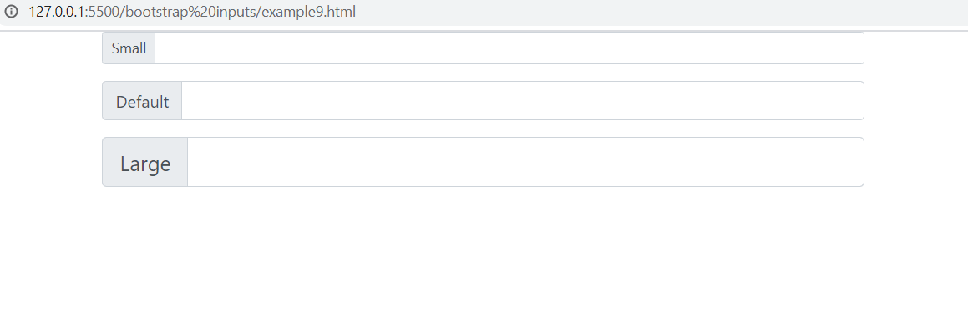
Output

Slide 35
BootStrap 5 Custom Inputs
Bootstrap 5 has classes for custom inputs: checkboxes, radios and select pickers.
The default checkboxes and radios can be overwritten by the Bootstrap 5 classes.

Slide 36
BootStrap 5 Custom Inputs
This is done with the help of a class called .form-check.
This class improves the layout and behavior of their HTML elements and provides greater customization and cross browser consistency.

Slide 37
Stacked CheckBox
To get the custom Bootstrap 5 style for checkboxes we need to use the .form-check class together with the . form-check-input class.
For label element we will need .form-check-label class.
If we are using multiple checkboxes, they will be vertically stacked and aligned.

Slide 38
Example
<div class="container">
<div class="row">
<div class="col-8">
<div class="form-check">
<input
class="form-check-input"
type="checkbox"
value=""
id="flexCheckDefault"
/>
<label class="form-check-label" for="flexCheckDefault">
Default checkbox
</label>
</div>
<div class="form-check">
<input
class="form-check-input"
type="checkbox"
value=""
id="flexCheckChecked"
checked
/>
<label class="form-check-label" for="flexCheckChecked">
Checked checkbox
</label>
</div>
</div>
</div>
</div>

Slide 39
Disabled CheckBox
If we want to prevent all user interactions with a checkbox, we need to add the disabled attribute on the .form-check-input.

Slide 40
Example
<div class="container">
<div class="row">
<div class="col-8">
<div class="form-check">
<input
class="form-check-input"
type="checkbox"
value=""
id="flexCheckDisabled"
disabled
/>
<label class="form-check-label" for="flexCheckDisabled">
Disabled checkbox
</label>
</div>
<div class="form-check">
<input
class="form-check-input"
type="checkbox"
value=""
id="flexCheckCheckedDisabled"
checked
disabled
/>
<label class="form-check-label" for="flexCheckCheckedDisabled">
Disabled checked checkbox
</label>
</div>
</div>
</div>
</div>

Slide 41
Stacked RadioButton
To use the custom radio, we need to use the same approach as before.
The radio buttons will appear stacked as a default behaviour

Slide 42
Example
<div class="container">
<div class="row">
<div class="col-8">
<div class="form-check">
<input
class="form-check-input"
type="radio"
id="flexRadioDefault1"
/>
<label class="form-check-label" for="flexRadioDefault1">
Default radio
</label>
</div>
<div class="form-check">
<input
class="form-check-input"
type="radio"
id="flexRadioDefault2"
checked
/>
<label class="form-check-label" for="flexRadioDefault2">
Default checked radio
</label>
</div>
</div>
</div>
</div>

Slide 43
Inline RadioButton
We can group the checkboxes or radios on the same horizontal row by adding .form-check-inline to any .form-check.

Slide 44
Example
<div class="container">
<div class="row">
<div class="col-8">
<div class="form-check form-check-inline">
<input
class="form-check-input"
type="checkbox"
id="inlineCheckbox1"
value="option1"
/>
<label class="form-check-label" for="inlineCheckbox1">1</label>
</div>
<div class="form-check form-check-inline">
<input
class="form-check-input"
type="checkbox"
id="inlineCheckbox2"
value="option2"
/>
<label class="form-check-label" for="inlineCheckbox2">2</label>
</div>
<div class="form-check form-check-inline">
<input
class="form-check-input"
type="checkbox"
id="inlineCheckbox3"
value="option3"
disabled
/>
<label class="form-check-label" for="inlineCheckbox3"
>3 (disabled)</label
>
</div>
</div>
</div>
</div>

Slide 45
Disabled RadioButton
If we want to prevent all user interactions with a radio button, we need to add the disabled attribute and the associated <label>s are automatically styled to match with a lighter color to help indicate the input’s state.

Slide 46
Example
<div class="container">
<div class="row">
<div class="col-8">
<div class="form-check">
<input
class="form-check-input"
type="radio"
name="flexRadioDisabled"
id="flexRadioDisabled"
disabled
/>
<label class="form-check-label" for="flexRadioDisabled">
Disabled radio
</label>
</div>
<div class="form-check">
<input
class="form-check-input"
type="radio"
name="flexRadioDisabled"
id="flexRadioCheckedDisabled"
checked
disabled
/>
<label class="form-check-label" for="flexRadioCheckedDisabled">
Disabled checked radio
</label>
</div>
</div>
</div>
</div>

Slide 47
Select Picker
To change the style of a select picker from the default browser style to the Bootstrap 5 style, we need to add the .form-select class to the <select> control

Slide 48
Example
<div class="container">
<div class="row">
<div class="col-8">
<select class="form-select">
<option selected>This is a select menu</option>
<option value="1">Option 1</option>
<option value="2">Option 2</option>
<option value="3">Option 3</option>
</select>
</div>
</div>
</div>

